Slide 1
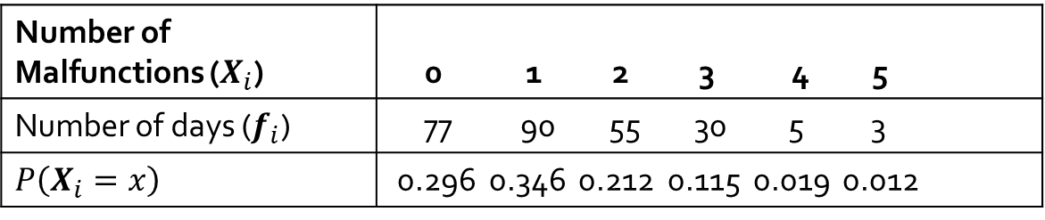
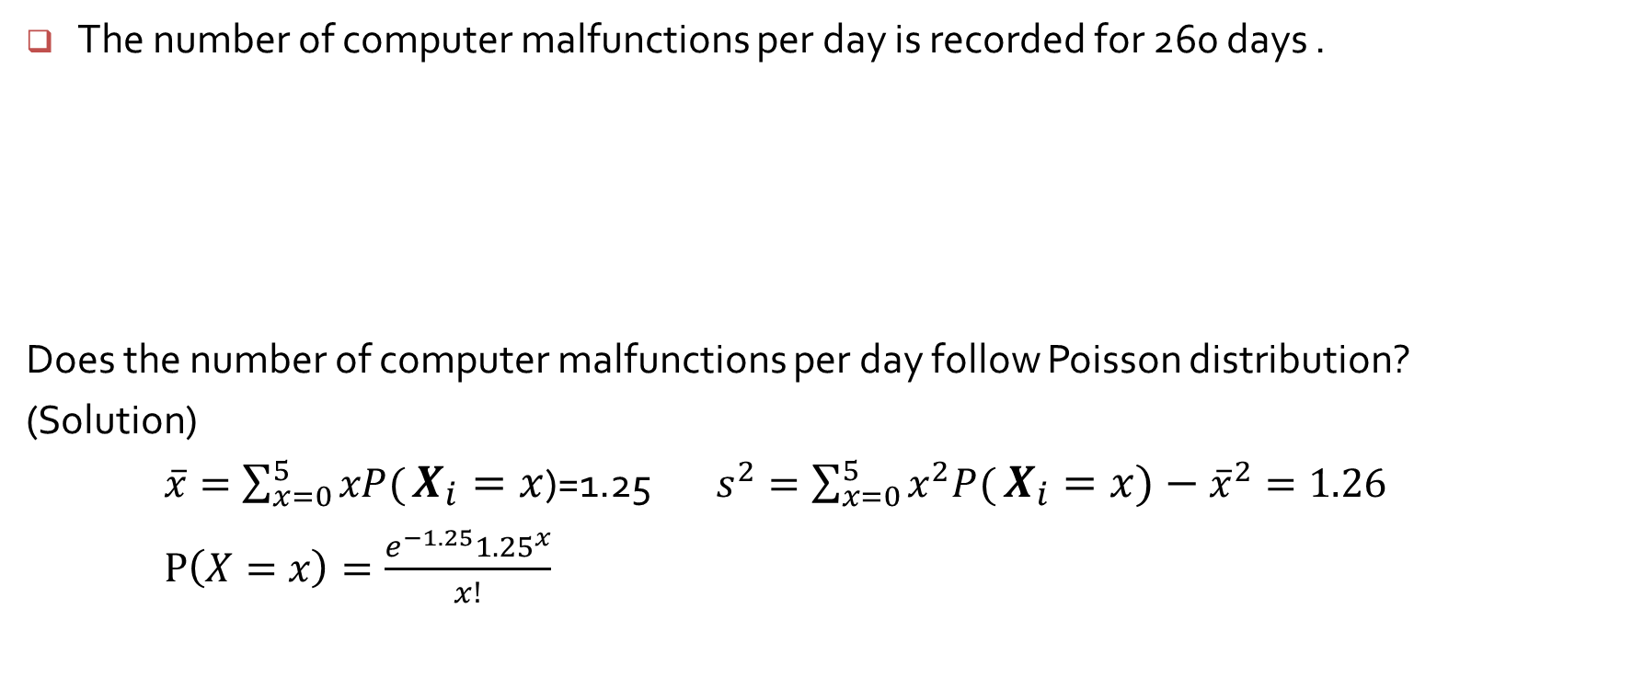
Poisson Distribution
The number of computer malfunctions per day is recorded for 260 days .
Does the number of computer malfunctions per day follow Poisson distribution?
(Solution)
$\overline{x}=\sum_{x=0}^{5}{xP(}X_{i}=x$)=1.25 $s^{2}=\sum_{x=0}^{5}{x^{2}P(}X_{i}=x)−{\overline{x}}^{2}=1.26$
$P\left(X=x\right)=\frac{e^{−1.25}{1.25}^{x}}{x!}$
Number of Malfunctions ($X_{i}$) | 0 1 2 3 4 5
Number of days ($f_{i}$) | 77 90 55 30 5 3
$$P\left(X_{i}=x\right)$$ | 0.296 0.346 0.212 0.115 0.019 0.012

Slide 2
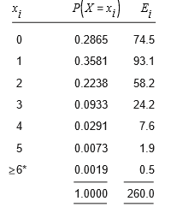

Poisson Distribution
$260×P\left(X=1\right)=200×0.3581=93.1$
$χ^{2}=\sum_{all cells}{\frac{{\left(observed−expected\right)}^{2}}{expected} }$is approximated by $χ^{2}$ distribution providing none of the expected frequencies are less than 5.
When expected frequencies fall below 5, then groups or classes must be combined.

Slide 3
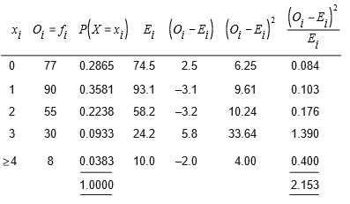
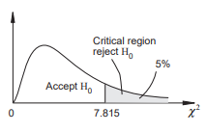
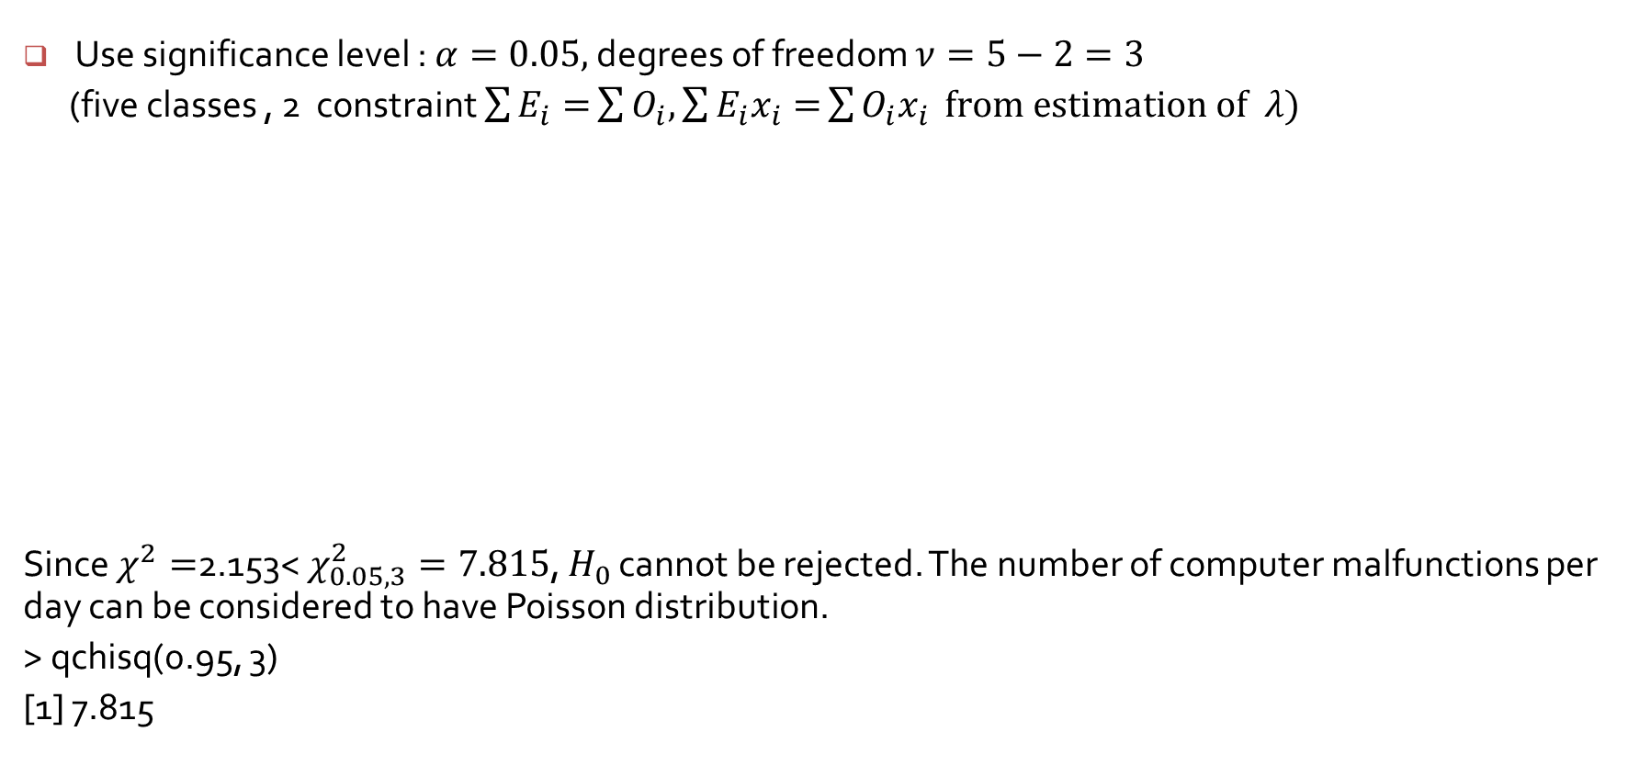
Poisson Distribution
Use significance level : $α=0.05,$degrees of freedom $ν=5−2=3$
(five classes , 2 constraint $\sum{E_{i}=}\sum{O_{i},\sum{E_{i}x_{i}=}\sum{O_{i}x_{i}} from estimation of λ)}$
Since $χ^{2}=$2.153< $χ_{0.05, 3}^{2}=7.815$, $H_{0}$ cannot be rejected. The number of computer malfunctions per day can be considered to have Poisson distribution.
> qchisq(0.95, 3)
[1] 7.815

Slide 4
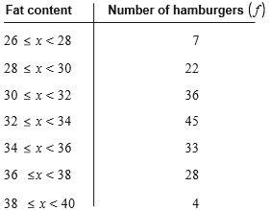
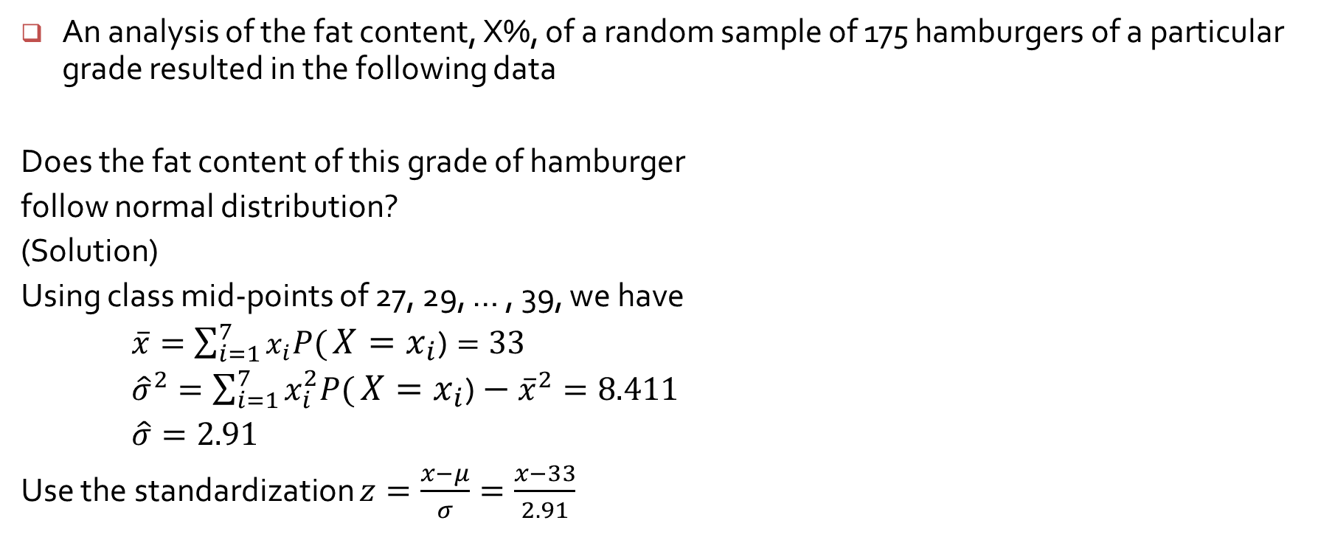
Normal Distribution
An analysis of the fat content, X%, of a random sample of 175 hamburgers of a particular grade resulted in the following data
Does the fat content of this grade of hamburger
follow normal distribution?
(Solution)
Using class mid-points of 27, 29, … , 39, we have
$\overline{x}=\sum_{i=1}^{7}{x_{i}P(}X=x_{i}\text{)}=33$
${\hat{σ}}^{2}=\sum_{i=1}^{7}{x_{i}^{2}P(}X=x_{i}\text{)}−{\overline{x}}^{2}=8.411$
$\hat{σ}=2.91$
Use the standardization $z=\frac{x−μ}{σ}=\frac{x−33}{2.91}$

Slide 5
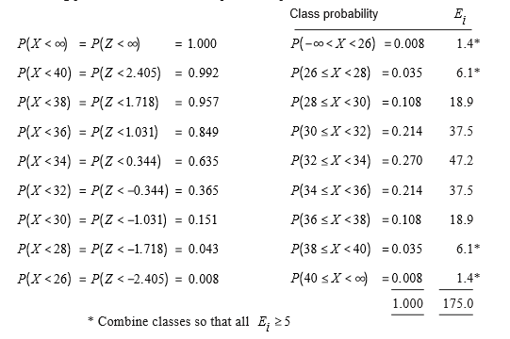
Normal Distribution

Slide 6
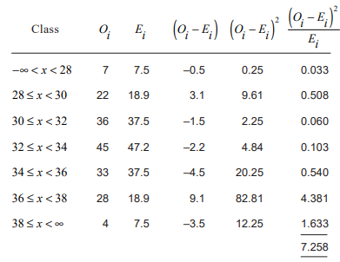
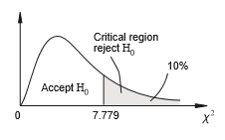

Normal Distribution
Use significance level : $α=0.10,$degrees of freedom $ν=7−3=4$
(7 classes , 3 constraint $\sum{E_{i}=}\sum{O_{i },\sum{E_{i}x_{i}=}\sum{O_{i}x_{i}} from estimation of μ,}$
$\sum{E_{i}x_{i}^{2}=}\sum{O_{i}x_{i}^{2}=}from estimation of{ σ}^{2})$
Since $χ^{2}=$7.258 < $χ_{0.10, 4}^{2}=7.779$, $H_{0}$ cannot be rejected. The fat content of a hamburger can be considered to have normal distribution.
> qchisq(0.9, 4)
[1] 7.779

